Slide 1


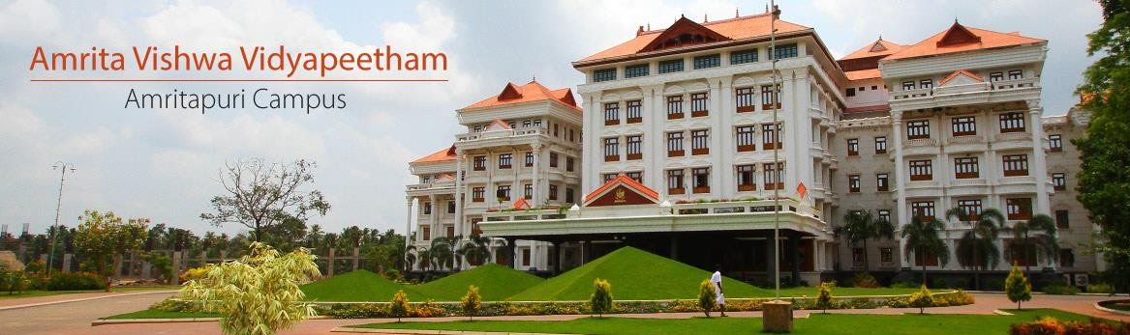

19CSE301 COMPUTER NETWORKS
3-0-3 4

Slide 2


Network Hardware

Slide 3
Network Hardware
Local Area Networks
Metropolitan Area Networks
Wide Area Networks
Wireless Networks
Home Networks
Internetworks
There are many different types of network, which can be used for different purposes and by different types of
people and organization. Here are some of the networks

Slide 4
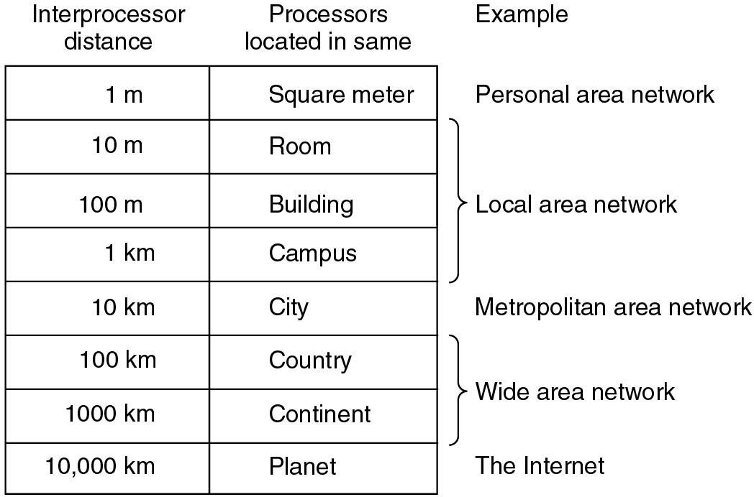
Classification of interconnected processors by scale

Slide 5
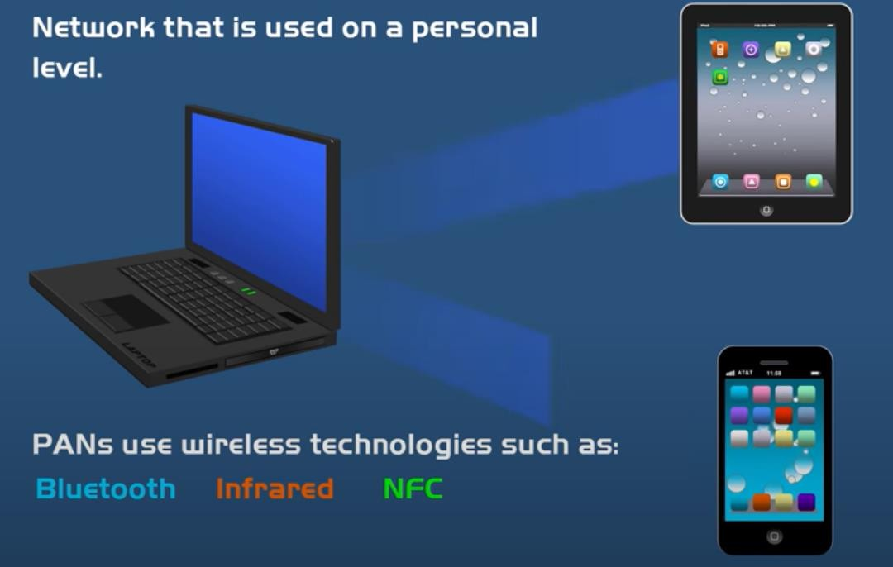
Personal Area Network ( PAN)

Slide 6
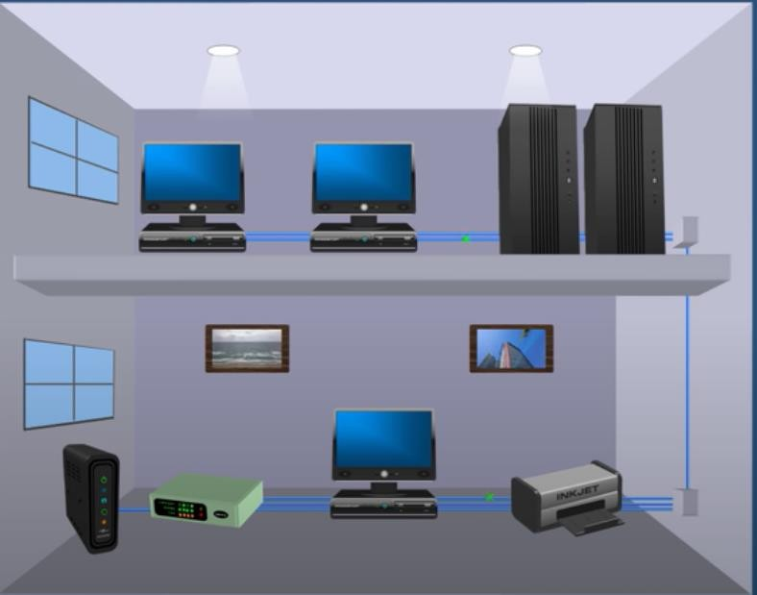
Local Area Networks (LANs)
Group of devices (computers servers, printers , switches etc located in the same building
In close proximity to each other
Most common type of LAN is ethernet LAN

Slide 7
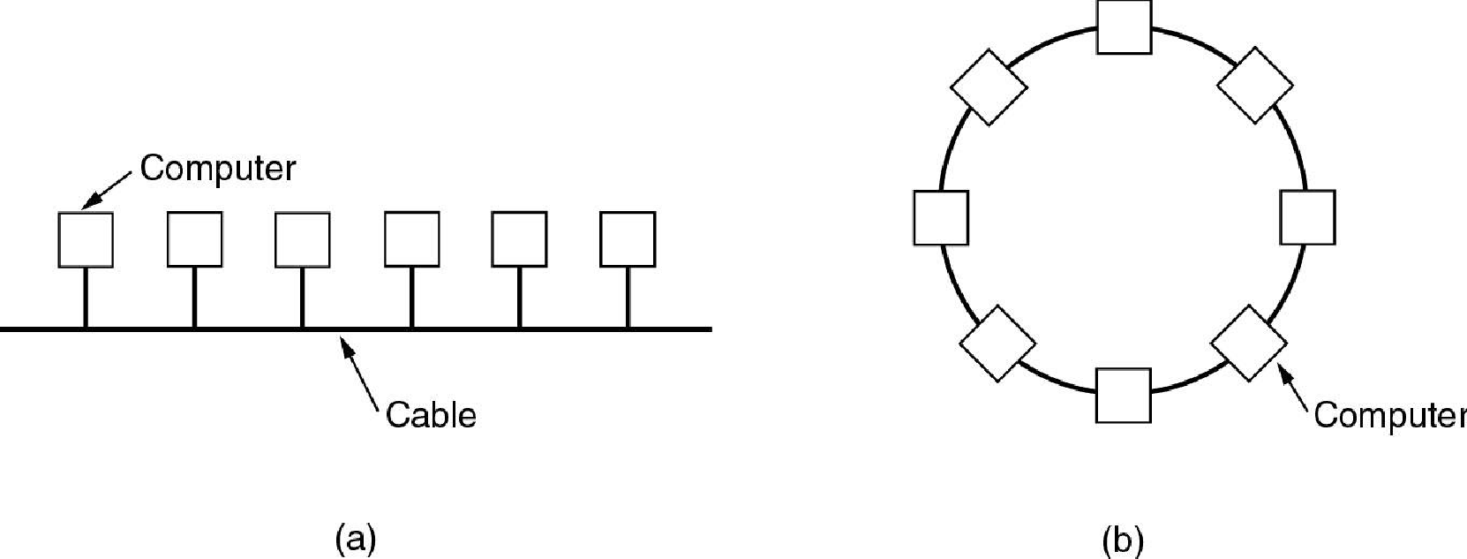
Local Area Networks (LANs)
A local area network or LAN is a network that connects computers within a limited area. This might be in a
school, an office or even a home.
Characterics of LANs: (a) privated-owned, (b) small size,
(c) transmission technology, (d) topology
Ethernets are most popular (up to 10 Gb/s)
(a) Bus
(b) Ring

Slide 8
Local Area Networks
Characteristics
small size
transmission technology
single cable
topology:
bus
Ethernet (IEEE 802.3): 10 or 100 Mbps
ring
IBM token ring (IEEE 802.5): 4 or 16 Mbps
Channel allocation of broadcast networks ^{IEEE 802 is a collection}
of networking standards that cover the physical and data-link layer specifications for
static: each machine has an allocated time slot
Dynamic: each machine can sense a channel is busy before they send data.
technologies such as Ethernet and wireless

Slide 9
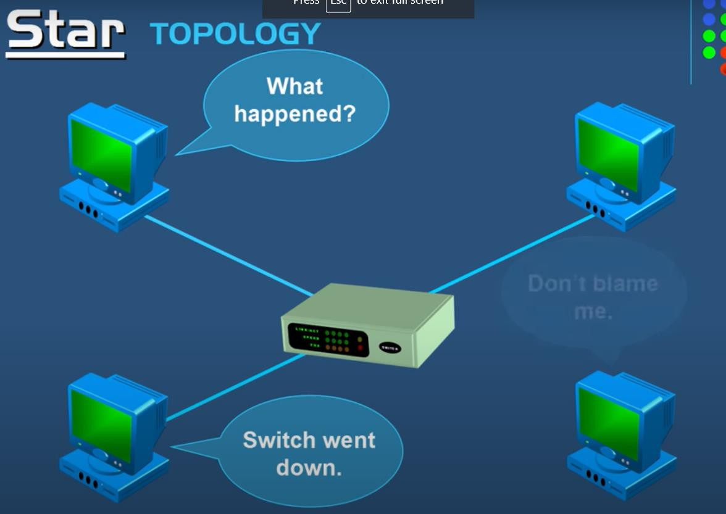
Network Topologies- STAR
Pros
If N devices are connected to each other in star topology, then the number of cables required to connect them is N. So, it is easy to set up.
Each device require only 1 port i.e. to connect to the hub.
Cons
If the concentrator (hub) on which the whole topology relies fails, the whole system will crash down.
Cost of installation is high.
Performance is based on the single concentrator i.e. hub.

Slide 10
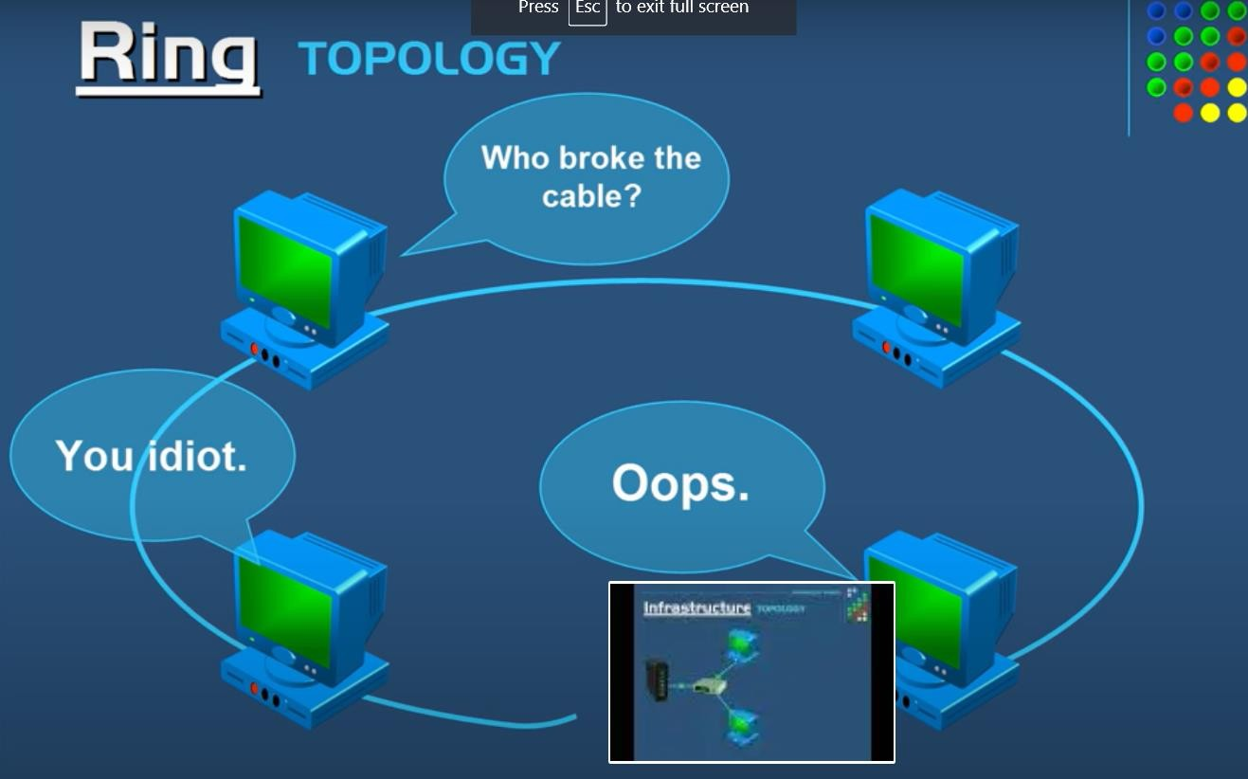
Network Topologies- RING
Advantages of this topology :
All data flows in one direction, reducing the chance of packet collisions.
A network server is not needed to control network connectivity between each workstation.
Data can transfer between workstations at high speeds.
Cheap to install and expand.
Problems with this topology :
If one computer goes wrong all will
go wrong
Troubleshooting is difficult in this topology.
Addition of stations in between or removal of stations can disturb the whole topology.

Slide 11
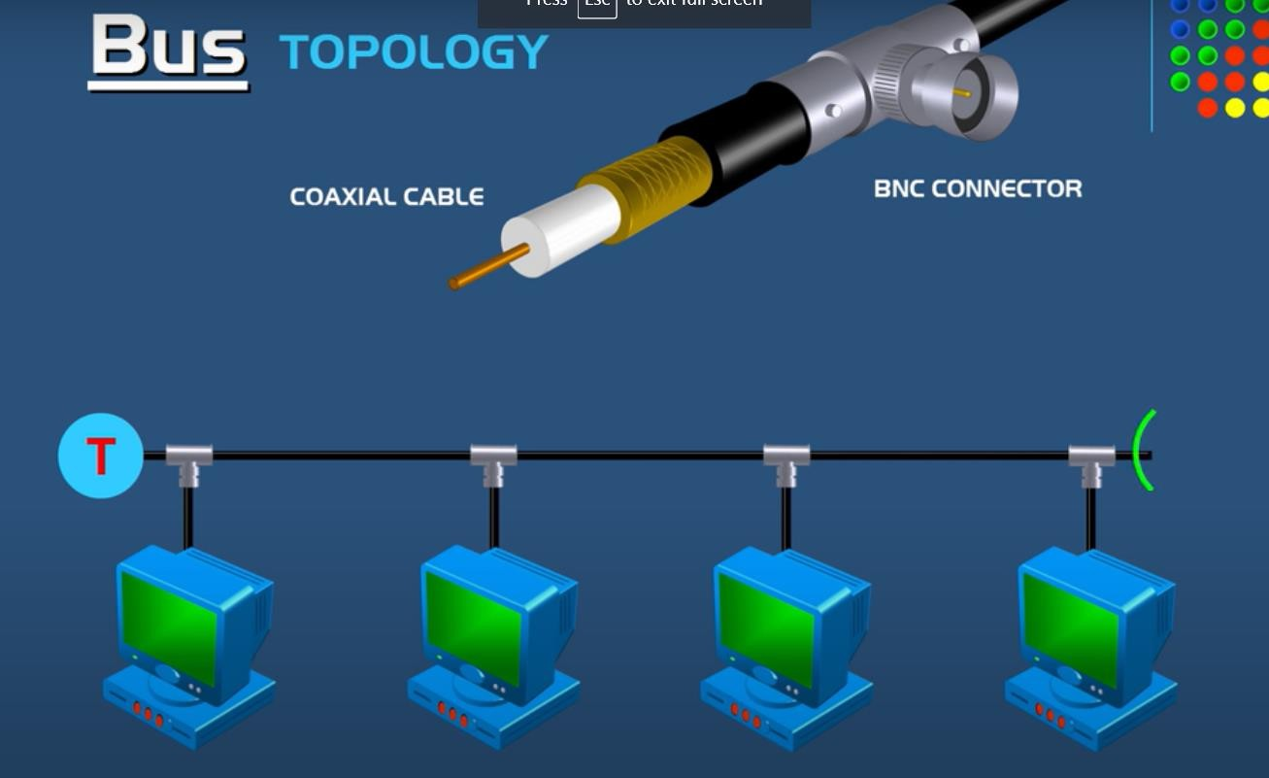
Network Topologies- BUS
Advantages of this topology :
If N devices are connected to each other in bus topology, then the number of cables required to connect them is 1 ?which is known as backbone cable and N drop lines are required.
Cost of the cable is less as compared to other topology, but it is used to built small networks.
Problems with this topology :
If the common cable fails, then the whole system will crash down.
If the network traffic is heavy, it increases
collisions in the network..
Terminator gets open data flow disrupted

Slide 12
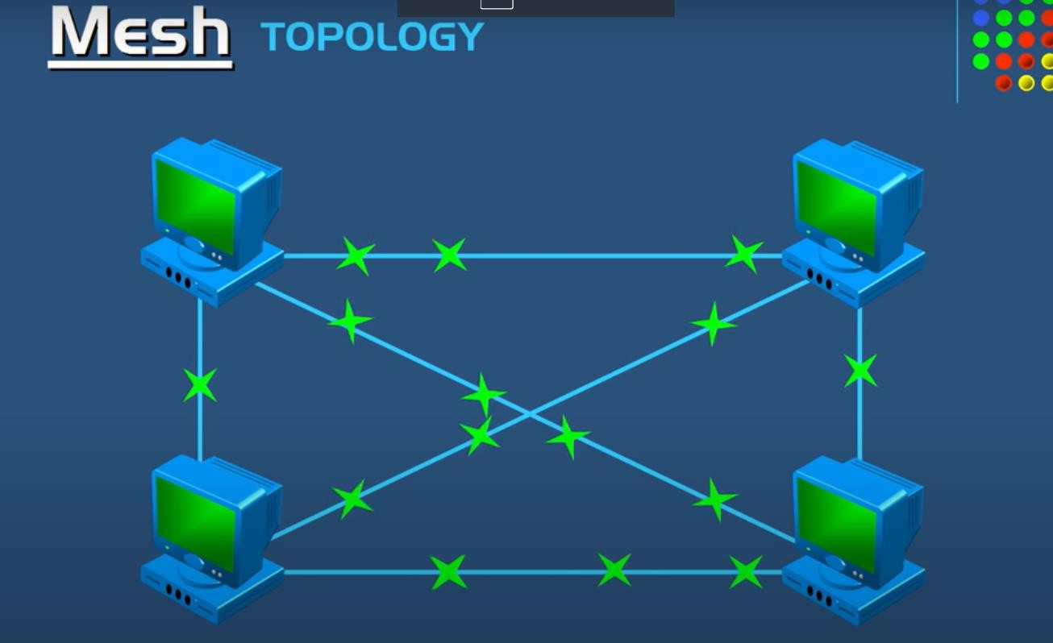
Network Topologies- MESH
Advantages of a mesh topology
Manages high amounts of traffic, because multiple devices can transmit data simultaneously.
A failure of one device does not cause a break in the network or transmission of data.
Adding additional devices does not disrupt data transmission between other devices. Disadvantages of a mesh topology
The cost to implement is higher than other network topologies, making it a less desirable option.
Building and maintaining the topology is difficult and time consuming.
The chance of redundant connections is high, which adds to the high costs and potential for reduced efficiency.

Slide 13
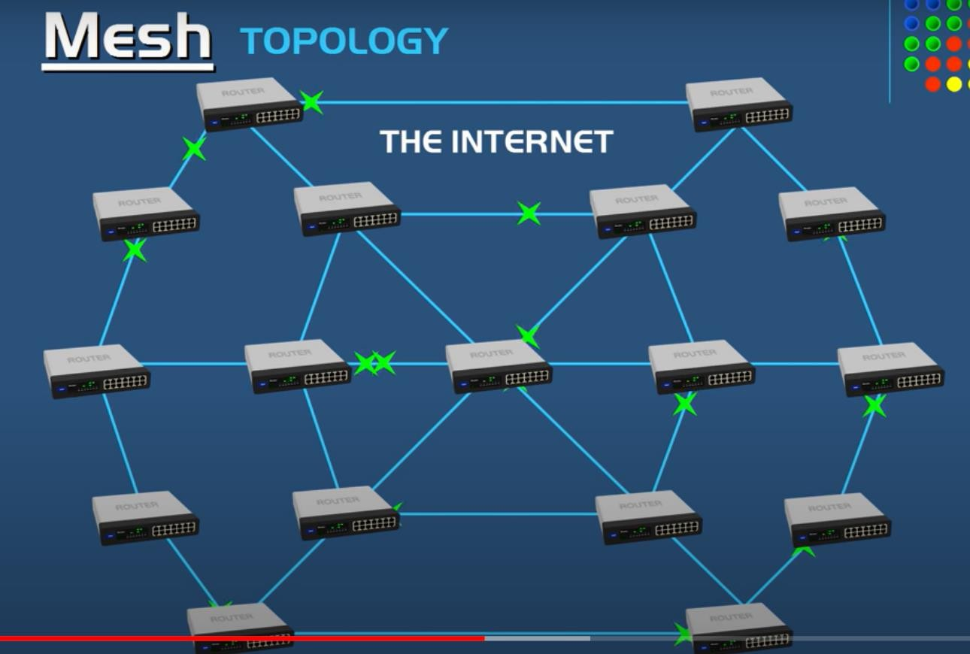

Slide 14





